Slide 1
Cypher Patterns

Slide 2


Node Patterns
Anonymous
Labeled
Labeled + property
Variable binding

Slide 3


Relationship Patterns
Anonymous
Typed
Directed - Outgoing
Directed - Incoming

Slide 4


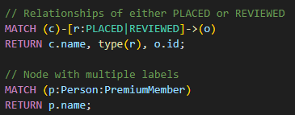

Combined Patterns
Chained
Variable-Length
Multi-Type & Multi-Label
Named paths

Slide 5

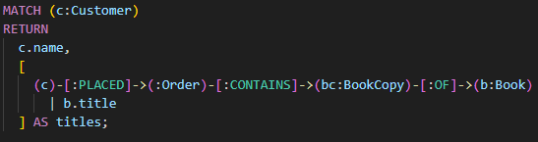
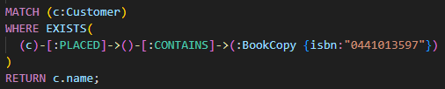
Combined Patterns
Optional
Pattern Comprehensions

Slide 6


Creating & Merging Data
Create
Merge

Slide 7


Updating & Deleting Data
Update
Delete

Slide 8
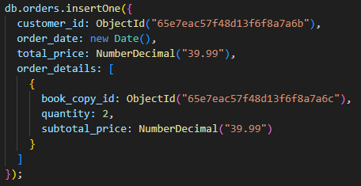
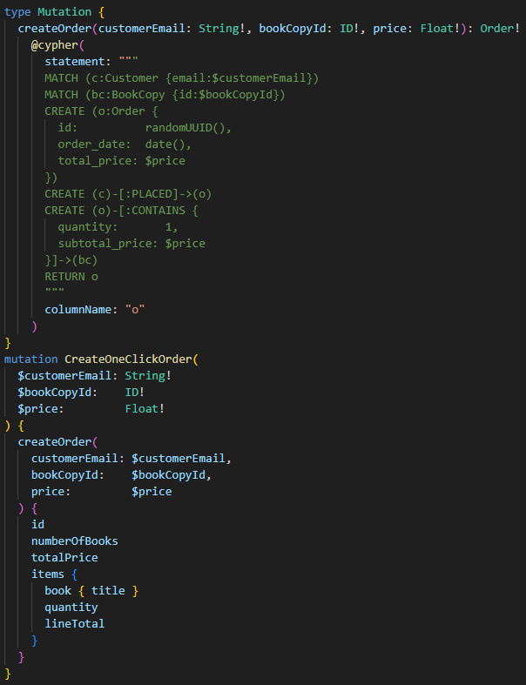
Comparing Data Modification Document vs. Graph
Insert

Slide 9
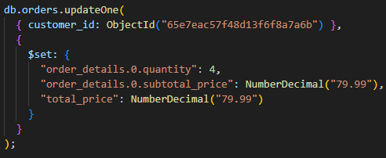
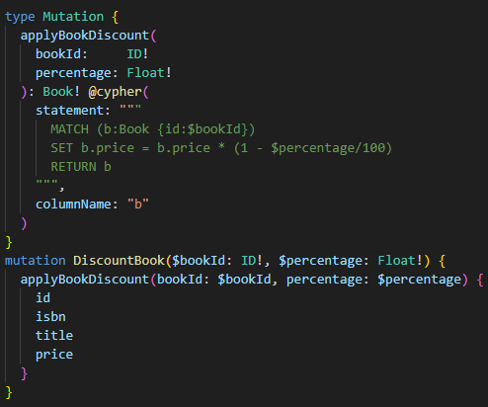
Comparing Data Modification Document vs. Graph
Update

Slide 10
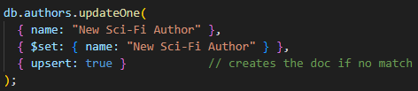
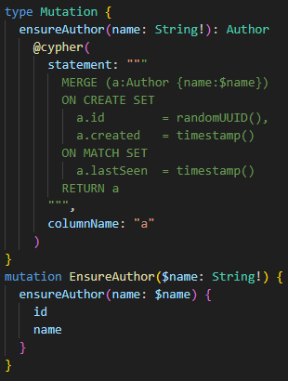
Comparing Data Modification Document vs. Graph
Upsert

Slide 11
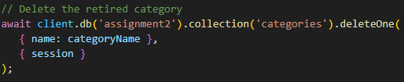
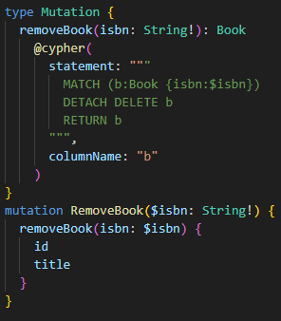
Comparing Data Modification Document vs. Graph
Delete

Slide 12
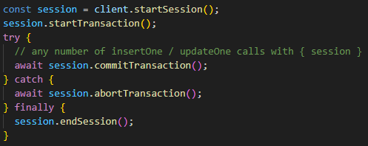
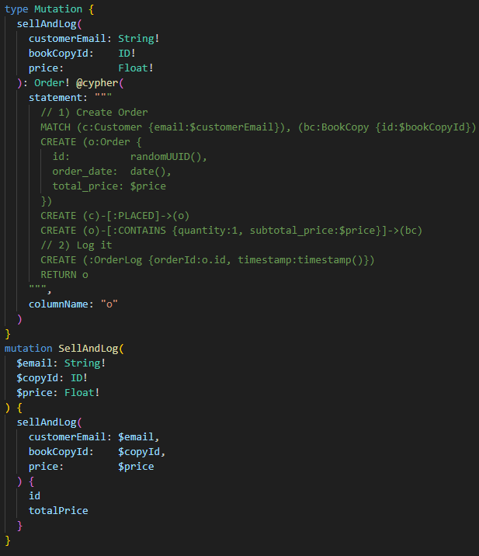
Comparing Data Modification Document vs. Graph
Transactions

Slide 13
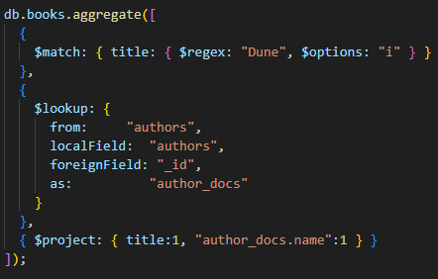
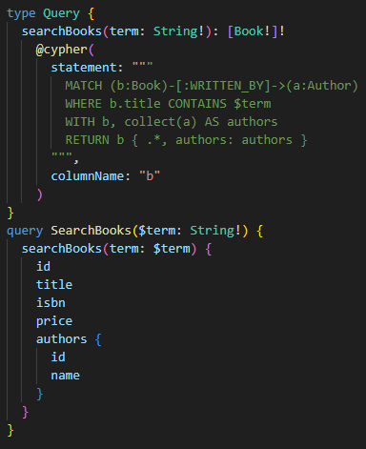
Comparing Data Modification Document vs. Graph
Fetch related data: Separate vs. Pattern

Slide 14
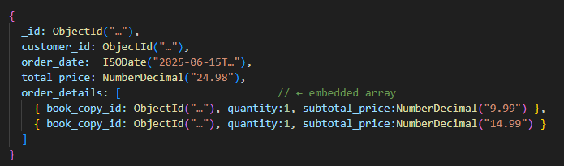
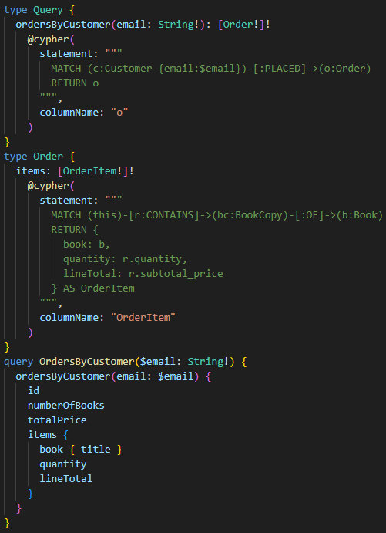
Comparing Data Modification Document vs. Graph
Embedded vs. Separate

Slide 15
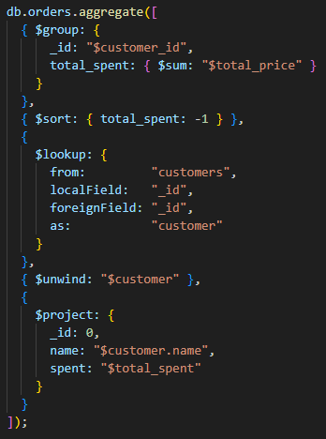
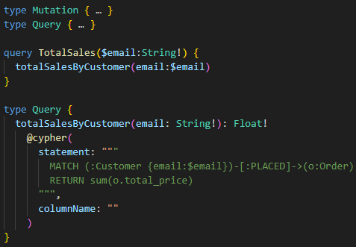
Comparing Data Modification Document vs. Graph
Declarative DSL

